Slide 1
BCG Case PowerCo Case
Capstone Project
Presentation

Slide 2
TABLE OF CONTENTS
01
02
03
PROBLEM & SOLUTION
OUR PROCESS
TARGET

Slide 3

OUR COMPANY
Boston Consulting Group partners with leaders in business and society to tackle their most important challenges and capture their greatest opportunities.

Slide 4
UNDERSTANDING THE PROBLEM
PowerCo
PowerCo is a major gas and electricity utility that supplies to corporate, SME (Small & Medium Enterprise), and residential customers.
The power-liberalization of the energy market in Europe has led to significant customer churn, especially in the SME segment.

Slide 5
PowerCo Managerment Hypothesis
Strategy
Churn
try a discounting strategy, with the head of the SME division suggesting that offering customers at high propensity to churn a discount might be effective
churn is driven by the customers’ price sensitivities

Slide 6
MAIN PROCEDURES OF PROJECT
DATA CLEANING
EXPLORATORY DATA ANALYSIS
FEATURE ENGINEERING
MODEL EVALUATION

Slide 7
CUSTOMER DATA
CHURN DATA
DATA NEEDED FOR ANALYSIS
HISTORICAL PRICE DATA
include characteristics of each client, for example, industry, historical electricity consumption, date joined as customer etc
indicate if customer has churned
indicate the prices the client charges to each customer for both electricity and gas at granular time intervals

Slide 8
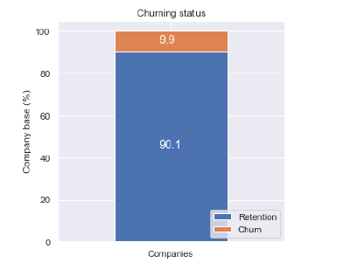
ANALYSIS
Churn
The retention rate of all customers is 90.1%, and the churn rate is 9.9%, a little bit high but still make sense.
Retention
Churn
90%
10%

Slide 9
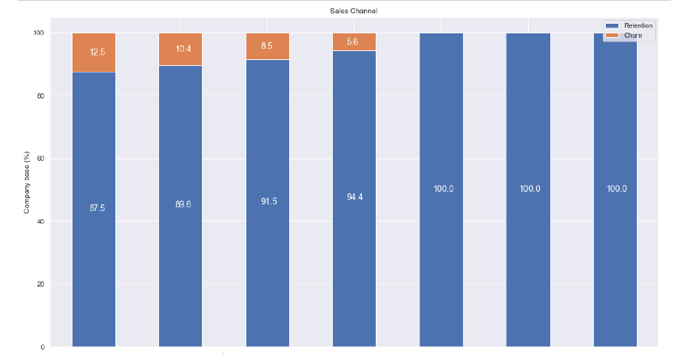
ANALYSIS - Sales Channel
There are 4 sales channels have lost customers, have to investigate in it.

Slide 10
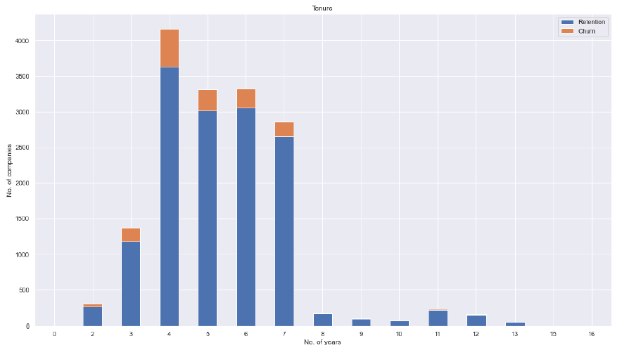
ANALYSIS – Tenure(Contract Period)
Churn
We can see that churn is low for customers which join lately or have made the contract for more than 7 years. Most churn customers happen within 3-7 years.
Retention
Churn
90%
10%

Slide 11
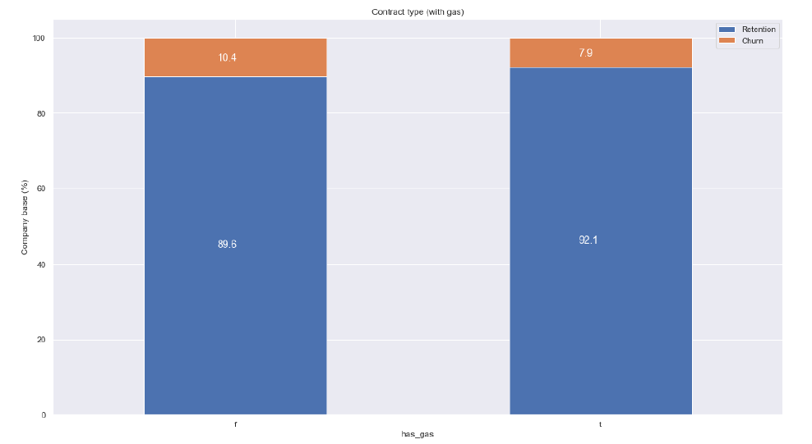
ANALYSIS – HAS GAS
We can see that churn is not a big difference for customers has gas or not.
NO GAS
HAS GAS

Slide 12

Model Evaluation - XGBoost
Model performance:
Accuracy : The most intuitive performance measure and it is simply a ratio of correctly predicted observation to the total observations.
Precision : The ratio of correctly predicted positive observations to the total predicted positive observations
Recall (Sensitivity): The ratio of correctly predicted positive observations to the all observations in actual class

Slide 13
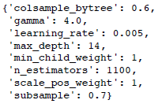
Exam Model – 5 Fold Cross Validation
Best parameters
found:

Slide 14
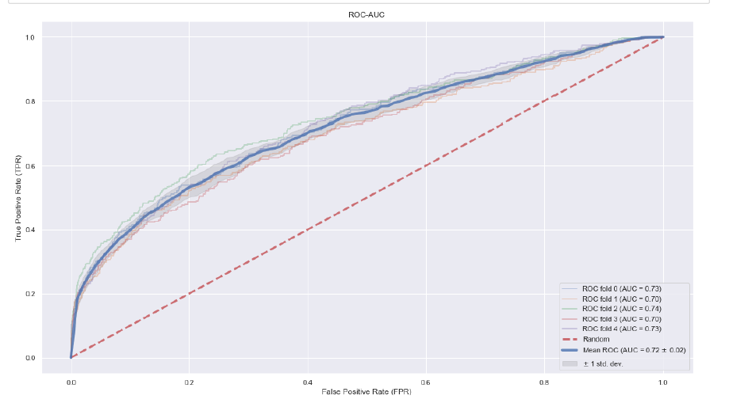
Model Evaluation – XGBoost ROC Curve
Model performance:

Slide 15
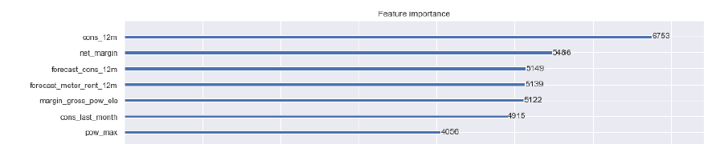
ANALYSIS – Feature Importance

Slide 16
ANALYSIS – Feature Importance Intuition
In the feature importance graph above we can see that yearly consumption, net margin and forecasted yearly consumption are the features that appear the most in our model and we could tell that these 3 features have a significant importance in our model. However, price is not rank front in the feature importance list.

Slide 17
Summary
Churn is indeed high in the SME division 9.9% between January 2016 and March 2016
Predictive model is able to predict churn but main driver is not customer price sensitivity: Yearly consumption, net margin, and forecasted consumption are the 3 largest drivers

Slide 18
THANKS

